Slide 1
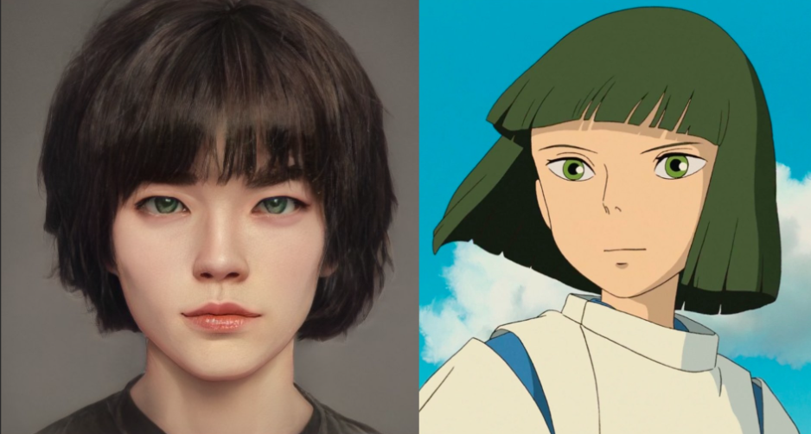
Real-to-Ghibli Image Translation
Presented By:
Venkatalakshmi Kottapalli
Satvik Kundargi

Slide 2
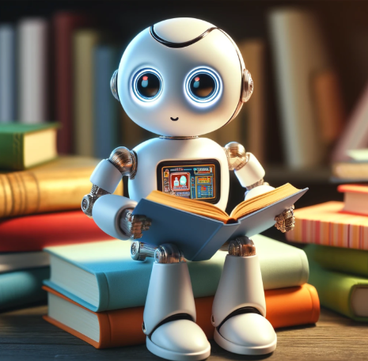
Agenda
Abstract
Introduction
Related Work
Dataset
Methods
Results
Comparative Analysis
Challenges
Conclusion
Future Work

Slide 3
Abstract
This project presents an image-to-image translation system that transforms real-world photographs into artwork inspired by the iconic style of Studio Ghibli.
By leveraging CycleGAN, Neural Style Transfer, and diffusion models, the system learns to map between photographic and artistic domains without the need for paired training data.
This work showcases practical applications in digital art, film production, and creative media, while contributing to advancements in neural style transfer and generative AI.

Slide 4
Introduction
• Transforming photos into Studio Ghibli style is a rising trend in digital art and social media.
• Ghibli’s aesthetic is known for vibrant colors, imaginative landscapes, and dream-like visuals.
• There's growing demand for automated tools to recreate this artistic style.
• Key challenge: No paired training data (no before-and-after examples).
• This project tackles the challenge using CycleGAN, Neural Style Transfer, and Diffusion Models—ideal for unpaired image translation.

Slide 5
Related work
Neural Style Transfer (NST)
Gatys et al. – Used CNNs to separate content and style for artistic synthesis. 🔗 Paper
Johnson et al. – Enabled real-time style transfer using perceptual loss. 🔗 Paper
StyleBank – Allowed multiple styles via interpretable filter banks. 🔗 Paper
Generative Adversarial Networks (GANs)
CycleGAN – Unpaired image translation using cycle-consistency loss. 🔗 Paper
Pix2Pix – Paired image translation with conditional GANs. 🔗 Paper
Contrastive Learning & Discriminator Reuse – Boosted translation with feature alignment and reuse. 🔗 Paper
Domain-Specific Stylization
Ghibli Diffusion Model – Trained to replicate Studio Ghibli's visual style. https://huggingface.co/nitrosocke/Ghibli-Diffusion

Slide 6
Dataset
Real to Ghibli Image Dataset
Source: Kaggle
Total Images: 5,000 high-quality images
Designed for AI-driven style transfer and image-to-image translation
Two Subsets:
trainA (2,500 Real-World Images): Includes human faces, nature scenes, buildings, and vehicles
trainB_ghibli (2,500 Ghibli-Style Images): Stylized visuals inspired by Studio Ghibli movies
Unpaired dataset: No direct real-to-Ghibli image mapping

Slide 7
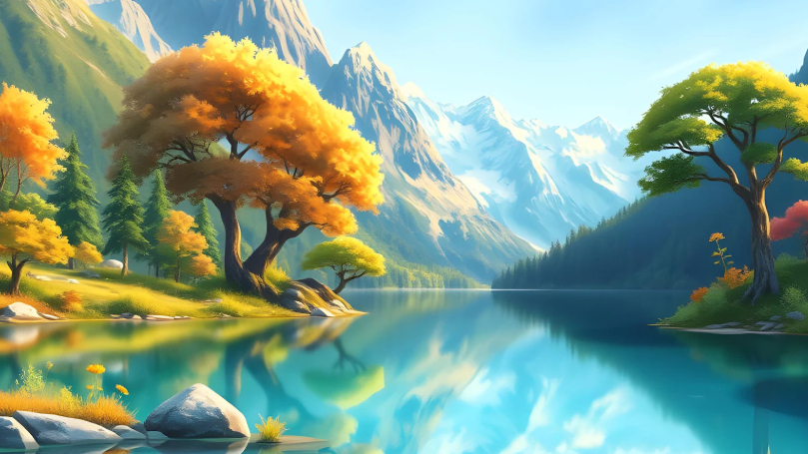
Methods

Slide 8
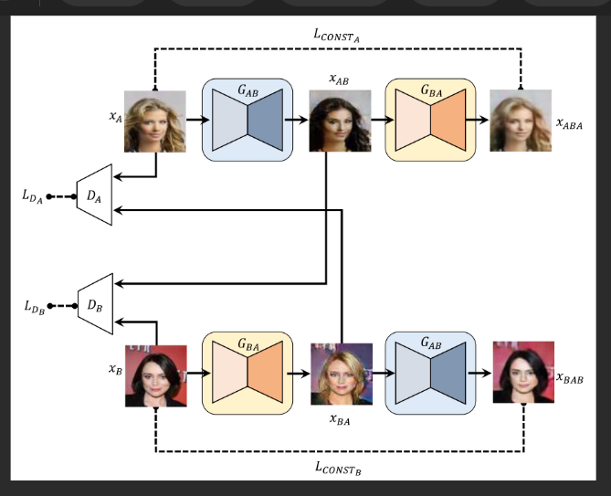
Cycle Gan
Unpaired Image-to-Image Translation
Key Components:
Dual Generator Networks
Real Photo → Ghibli Style Generator
Ghibli Style → Real Photo Generator
Architecture Flow:
Input Real Photo
Generator Transforms Image
Discriminator Validates Style
Cycle-Consistency Loss Ensures Content Preservation

Slide 9
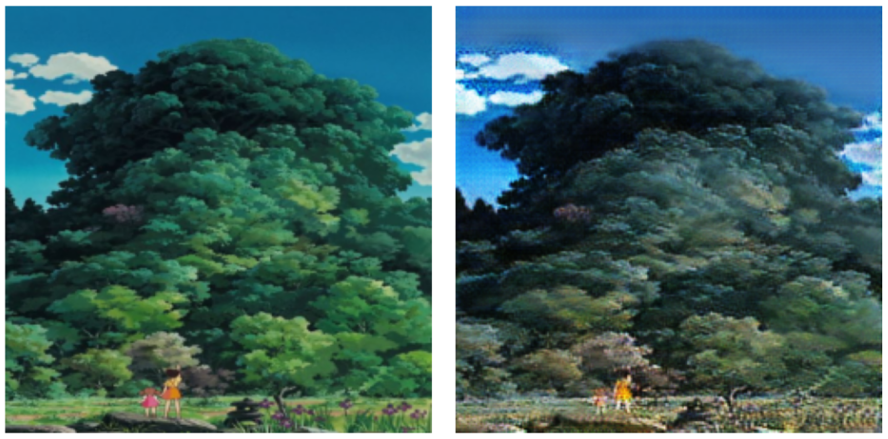
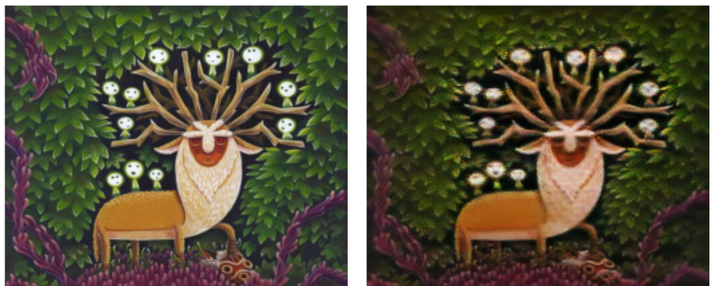
Cyclegan results

Slide 10
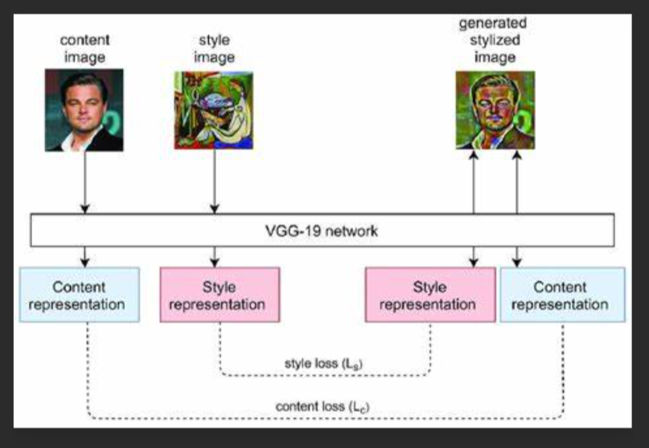
Neural style transfer
Artistic Style Extraction and Application
Key Components:
Pre-trained Deep Neural Network (VGG19)
Content Representation Extractor
Style Representation Extractor
Architecture Flow:
Separate Content and Style Features
Optimize Image to Match Content Structure
Apply Target Style Characteristics
Iterative Refinement of Stylized Image

Slide 11
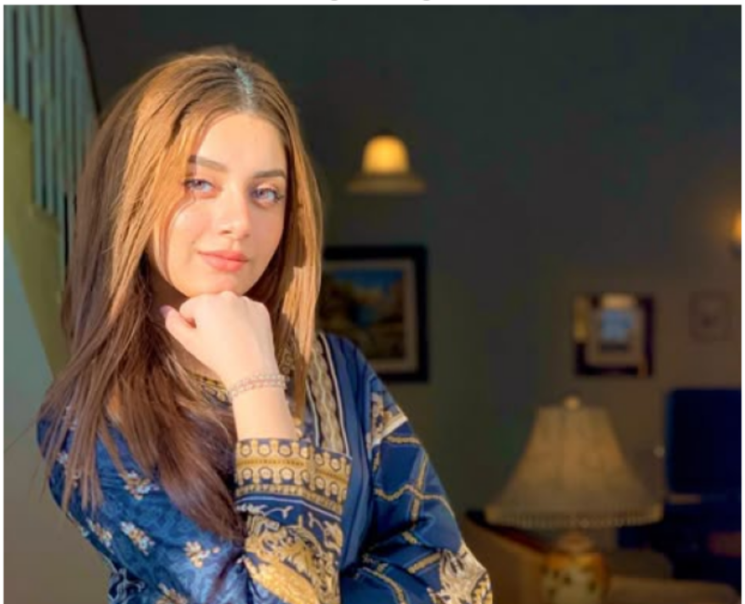
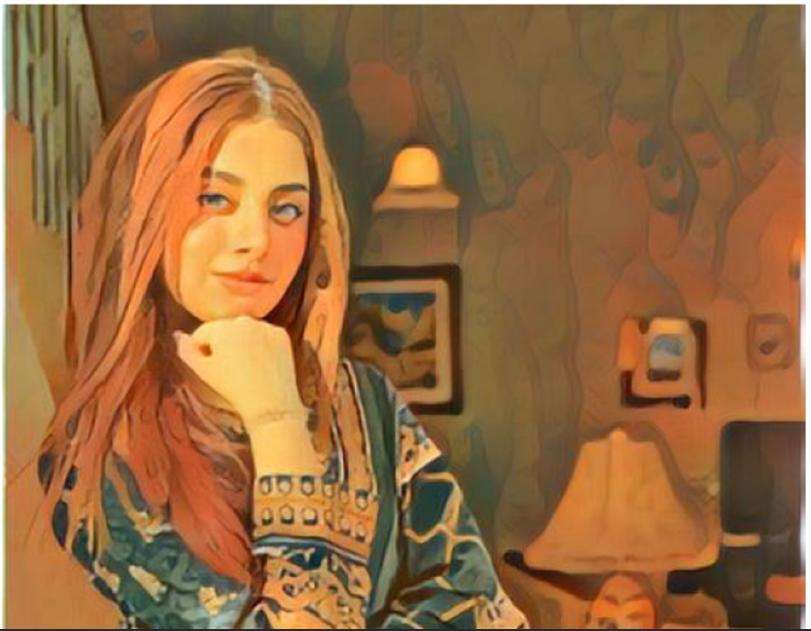
NST Results

Slide 12
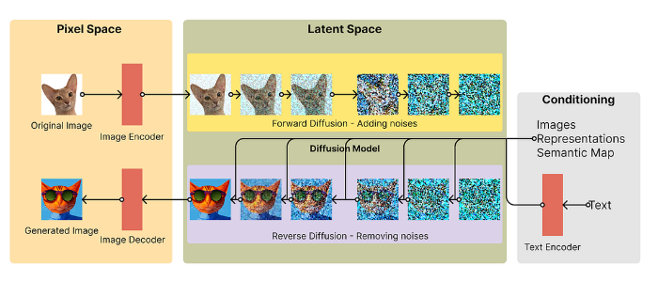
Ghibli diffusion model
Advanced Generative AI Transformation
Key Components:
Stable Diffusion Base
Ghibli-Specific Fine-Tuning
Nitrosocke's Pre-trained Model
Architecture Flow:
Initial Noise Generation
Iterative Denoising
Style-Specific Guidance
High-Resolution Image Synthesis

Slide 13
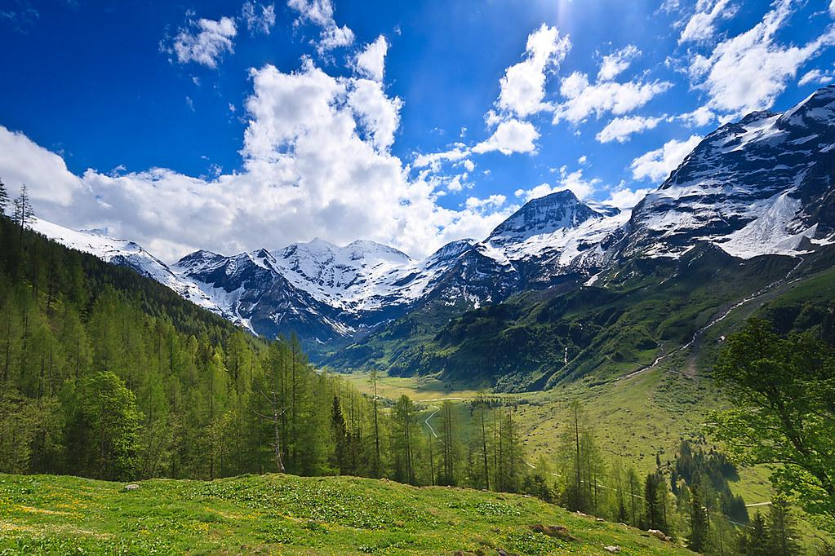
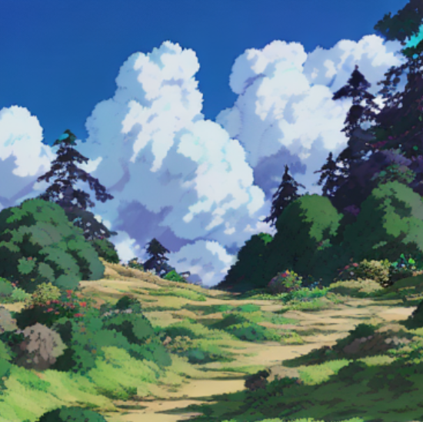
Diffusion model results

Slide 14
Comparison

Slide 15
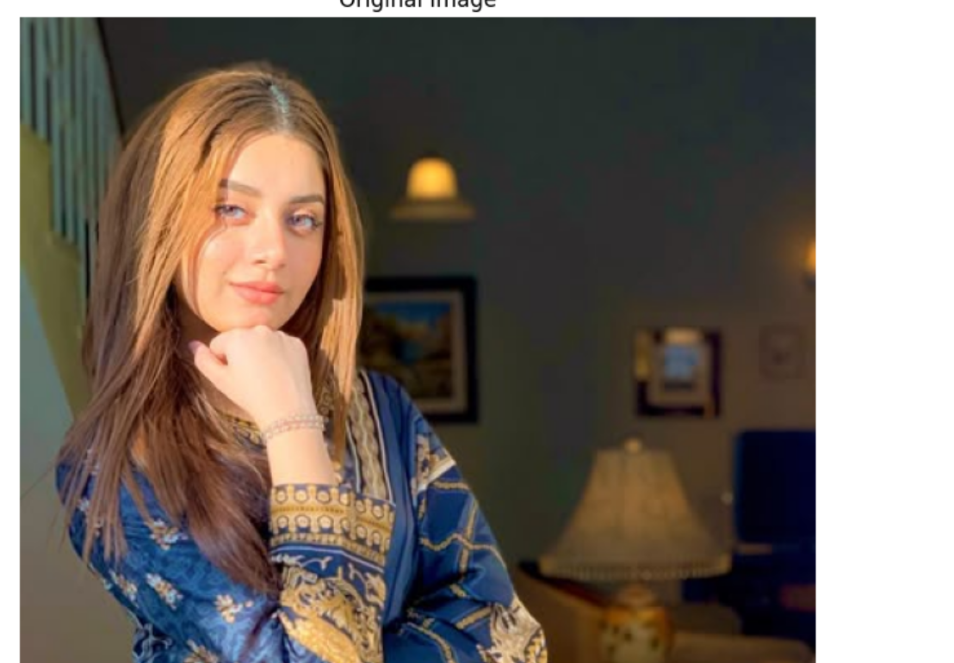
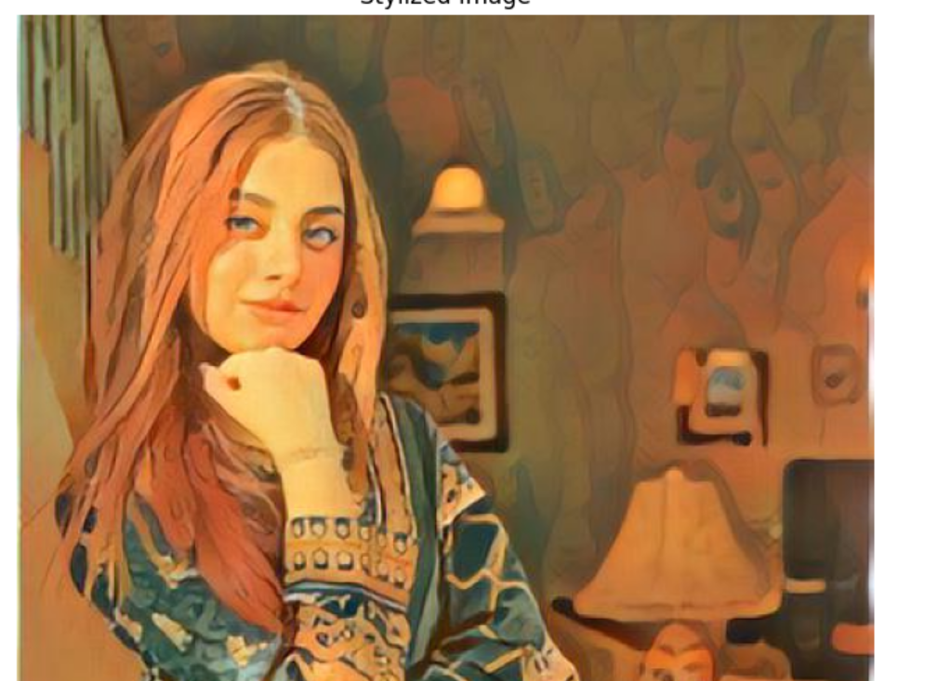
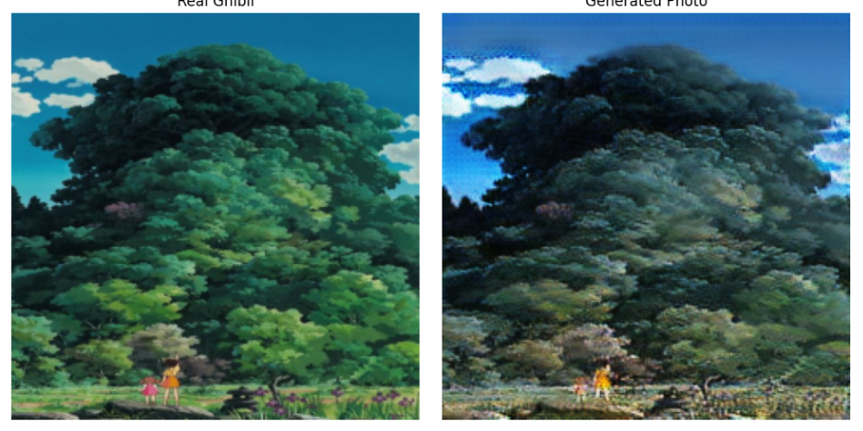
Neural Style Transfer
Ghibli Diffusion Model
CycleGAN

Slide 16
Best Model
Compared three style transfer techniques: CycleGAN, Neural Style Transfer, and Ghibli Diffusion Model.
Ghibli Diffusion Model consistently outperformed the others.
It captured Studio Ghibli’s soft, artistic aesthetics with greater clarity and appeal.
Maintained structural details while delivering cohesive, visually pleasing results.
Overall, it was the most effective technique in the comparison.

Slide 17
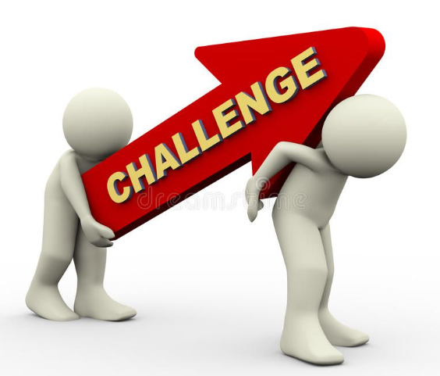
Challenges
Limitations in Model Training
Insufficient GPU Resources
Limited Training Data
Computational Constraints
Style Consistency Issues
Maintaining Image Semantics
Impact: Constrained model performance and generalization

Slide 18
Conclusion
Successfully implemented three advanced image translation techniques
Demonstrated unpaired image style transfer
Explored Ghibli artistic style transformation
Established baseline for future research
Primary Outcome: Foundational model for Ghibli-style image generation

Slide 19
Future work
Potential Improvements
Enhanced GPU Resource Utilization
Expanded Training Dataset
Fine-tuning Diffusion Models
Improving Style Consistency
Reducing Computational Overhead
Exploring More Advanced Architectures
Goal: Create More Robust and Efficient Style Transfer Models

Slide 20
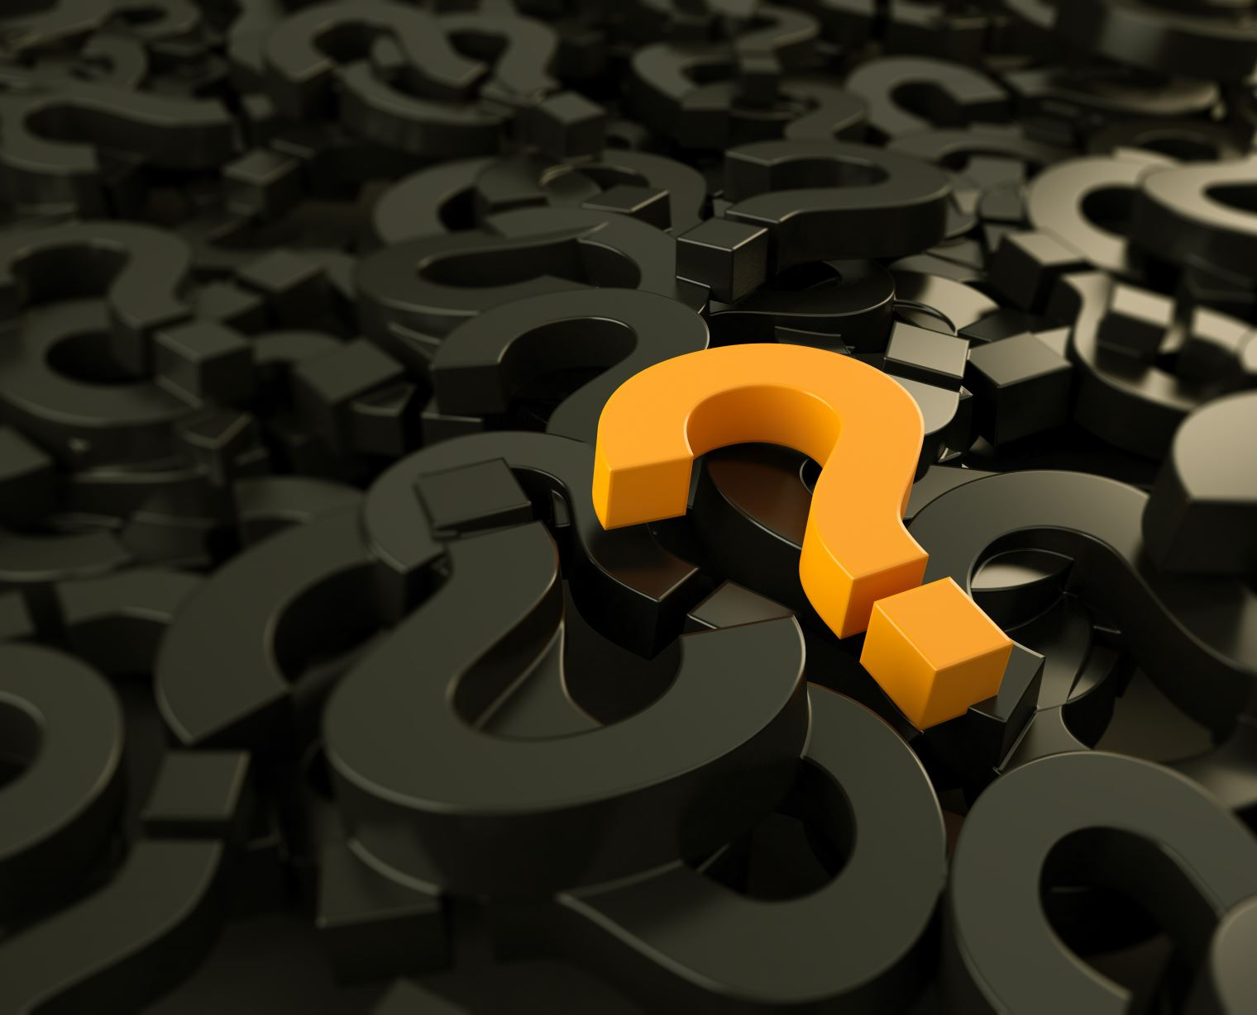
Any questions

Slide 21

Thank you
Venkatalakshmi Kottapalli
Satvik kundargi

